Slide 1
Hotel Booking Data Analysis Project - Part 1 & 2
Submitted By : G. Annamalai
Mentor: Mr. Munna Pandey

Slide 2
Introduction
Background: This project analyzes hotel booking data to uncover trends, customer behavior, and factors affecting key metrics like Average Daily Rate (ADR) and cancellations. The dataset includes information on booking details, customer demographics, and room preferences.
Objective: To provide insights that help optimize revenue, enhance customer satisfaction, and streamline hotel operations by examining:
Booking trends (seasonal patterns, popular room types)
Factors influencing cancellations
Customer segments contributing to higher ADR
Impact of amenities and other factors on ADR

Slide 3
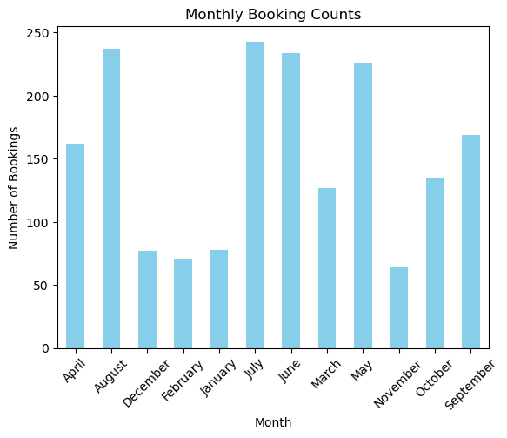
Hotel Booking Data Analysis Project - Part 1 Task 2: I. What are the peak booking periods for the hotel? II. Is there a relationship between lead time and the likelihood of a booking being cancelled? III. How do booking patterns vary by month, week, and day of the week?
monthly_bookings = df['arrival_date_month'].value_counts().sort_index()
monthly_bookings.plot(kind='bar', color='skyblue')
plt.title('Monthly Booking Counts')
plt.xlabel('Month')
plt.ylabel('Number of Bookings')
plt.xticks(rotation=45)
plt.show()

Slide 4
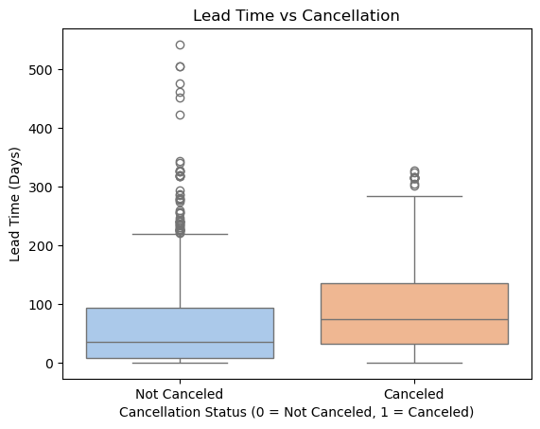
# Group by arrival_date_month and count the number of bookings
sb.boxplot(x='is_canceled', y='lead_time', data=df, palette='pastel')
plt.title('Lead Time vs Cancellation')
plt.xlabel('Cancellation Status (0 = Not Canceled, 1 = Canceled)')
plt.ylabel('Lead Time (Days)')
plt.xticks(ticks=[0, 1], labels=['Not Canceled', 'Canceled'])
plt.show()
correlation = df['lead_time'].corr(df['is_canceled'])
print(f"Correlation between lead time and cancellation likelihood: {correlation:.2f}")

Slide 5
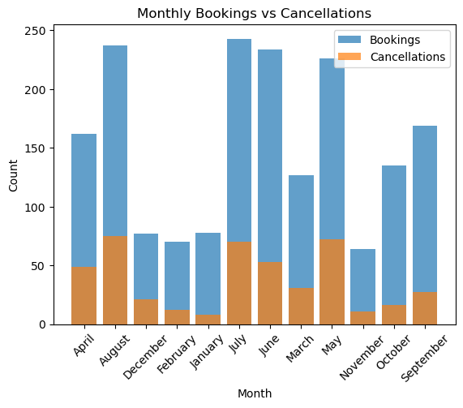
# Group by arrival_date_month for cancellations
monthly_cancellations = df[df['is_canceled'] == 1]['arrival_date_month'].value_counts().sort_index()
plt.bar(monthly_bookings.index, monthly_bookings.values, label='Bookings', alpha=0.7)
plt.bar(monthly_cancellations.index, monthly_cancellations.values, label='Cancellations', alpha=0.7)
plt.title('Monthly Bookings vs Cancellations')
plt.xlabel('Month')
plt.ylabel('Count')
plt.legend()
plt.xticks(rotation=45)
plt.show()

Slide 6
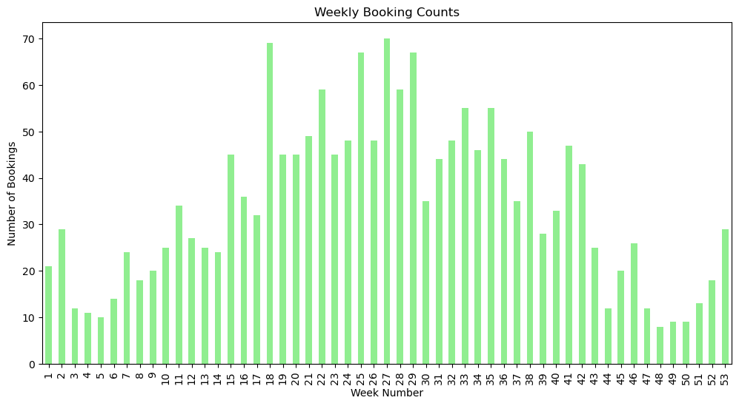
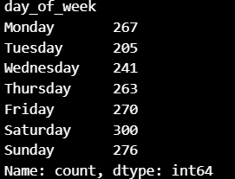
# Group by arrival_date_week_number
weekly_bookings = df['arrival_date_week_number'].value_counts().sort_index()
plt.figure(figsize=(12, 6))
weekly_bookings.plot(kind='bar', color='lightgreen')
plt.title('Weekly Booking Counts')
plt.xlabel('Week Number')
plt.ylabel('Number of Bookings')
plt.show()
# Assuming you have already loaded your DataFrame as df
df['arrival_date'] = pd.to_datetime(
df['arrival_date_year'].astype(str) + '-' +
df['arrival_date_month'].astype(str) + '-' +
df['arrival_date_day_of_month'].astype(str))
df['day_of_week'] = df['arrival_date'].dt.day_name()
day_of_week_bookings = df['day_of_week'].value_counts().reindex(
['Monday', 'Tuesday', 'Wednesday', 'Thursday', 'Friday', 'Saturday', 'Sunday'])
print(day_of_week_bookings)

Slide 7
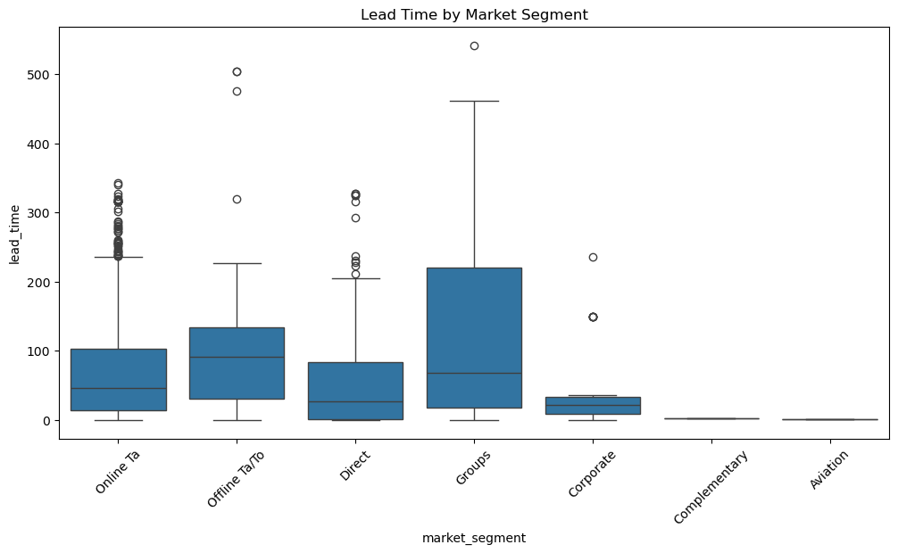
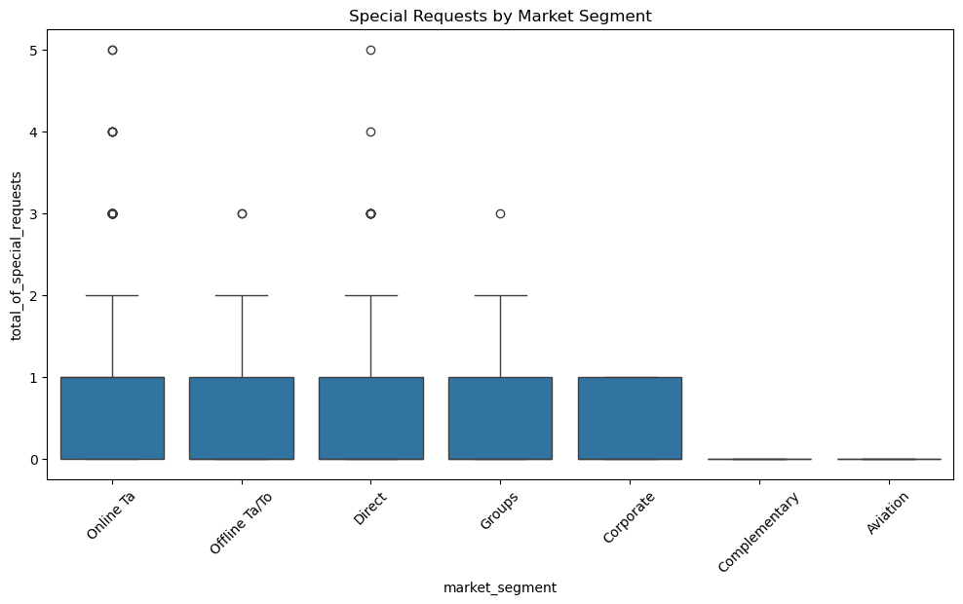
Task 4: I. Are there distinct patterns in the lead time, special requests, or room preferences for different customer segments? II. Which marketing channels are the most effective for reaching specific customer segments? III. How can marketing strategies be customized to resonate with specific customer segments, considering factors such as previous cancellations, booking lead time, and special requests?
# Lead Time by Market Segment
plt.figure(figsize=(12, 6))
sb.boxplot(x='market_segment', y='lead_time', data=df)
plt.title('Lead Time by Market Segment')
plt.xticks(rotation=45)
plt.show()
# Special Requests by Market Segment
plt.figure(figsize=(12, 6))
sb.boxplot(x='market_segment', y='total_of_special_requests', data=df)
plt.title('Special Requests by Market Segment')
plt.xticks(rotation=45)
plt.show()

Slide 8
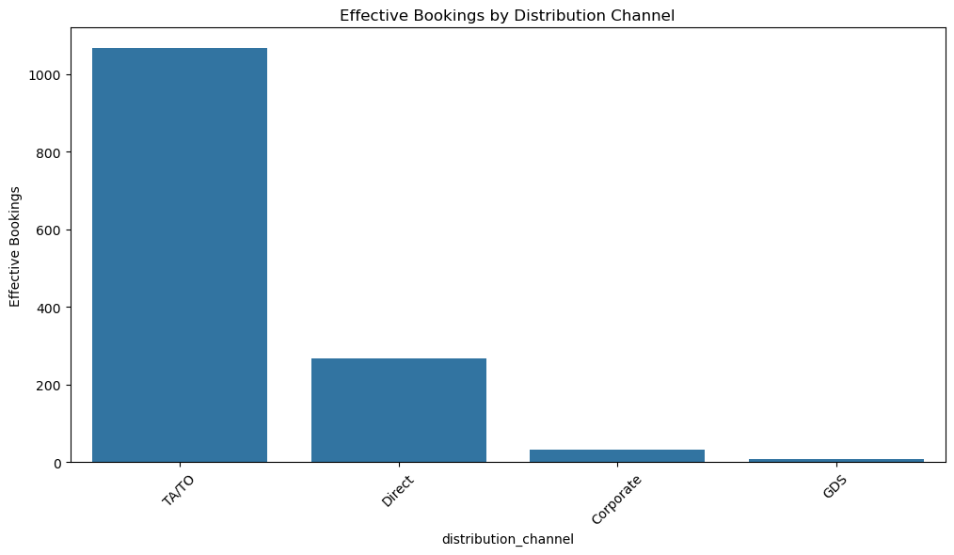
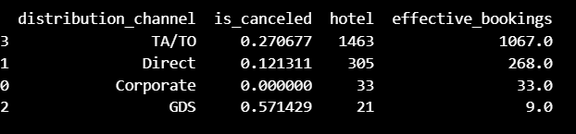
# Calculate conversion rates for each marketing channel
channel_analysis = df.groupby('distribution_channel').agg({
'is_canceled': 'mean', # Proportion of cancellations
'hotel': 'count' # Total bookings}).reset_index()
channel_analysis['effective_bookings'] = channel_analysis['hotel'] * (1 - channel_analysis['is_canceled'])
channel_analysis.sort_values(by='effective_bookings', ascending=False, inplace=True)
print(channel_analysis)
sb.barplot(x='distribution_channel', y='effective_bookings', data=channel_analysis)
plt.title('Effective Bookings by Distribution Channel')
plt.xticks(rotation=45)
plt.ylabel('Effective Bookings')
plt.show()

Slide 9
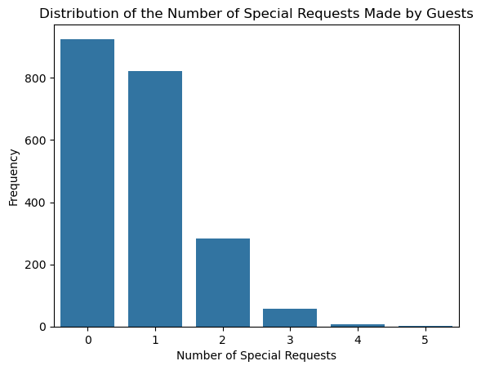
Hotel Booking Data Analysis Project - Part 2 Task 1: 1. What is the distribution of the number and types of special requests made by guests? 2. Is there any relation between special requests made by customers and the average daily rate? Additionally, explore customer preferences and expectations for different room types.
# Counting the number of special requests
special_requests_distribution = df['total_of_special_requests'].value_counts().reset_index()
special_requests_distribution.columns = ['Number of Special Requests', 'Frequency']
sb.barplot(x='Number of Special Requests', y='Frequency', data=special_requests_distribution)
plt.title('Distribution of the Number of Special Requests Made by Guests')
plt.xlabel('Number of Special Requests')
plt.ylabel('Frequency')
plt.show()

Slide 10
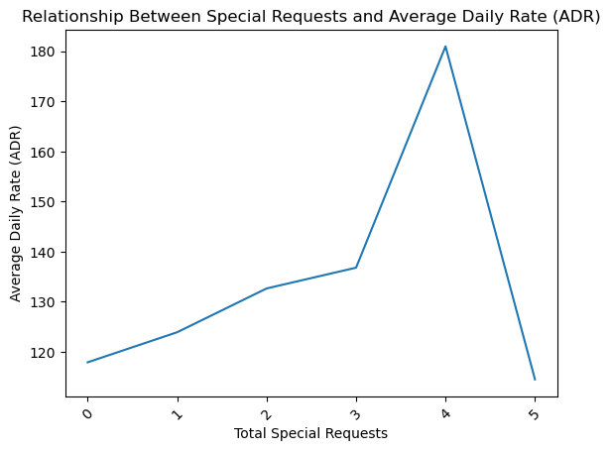
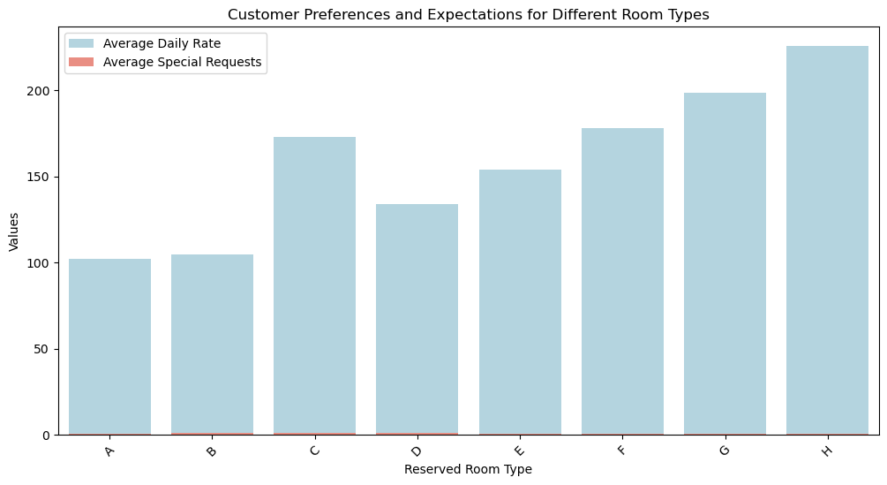
# Plotting the relationship between special requests and ADR
sb.lineplot(x='total_of_special_requests', y='adr', data=special_requests_adr)
plt.title('Relationship Between Special Requests and Average Daily Rate (ADR)')
plt.xlabel('Total Special Requests')
plt.ylabel('Average Daily Rate (ADR)')
plt.xticks(rotation=45)
plt.show()
# Plotting ADR and special requests by room type
plt.figure(figsize=(12, 6))
sb.barplot(x='reserved_room_type', y='adr', data=room_type_analysis, color='lightblue', label='Average Daily Rate')
sb.barplot(x='reserved_room_type', y='total_of_special_requests', data=room_type_analysis, color='salmon', label='Average Special Requests')
plt.title('Customer Preferences and Expectations for Different Room Types')
plt.xlabel('Reserved Room Type')
plt.ylabel('Values')
plt.legend()
plt.xticks(rotation=45)
plt.show()

Slide 11
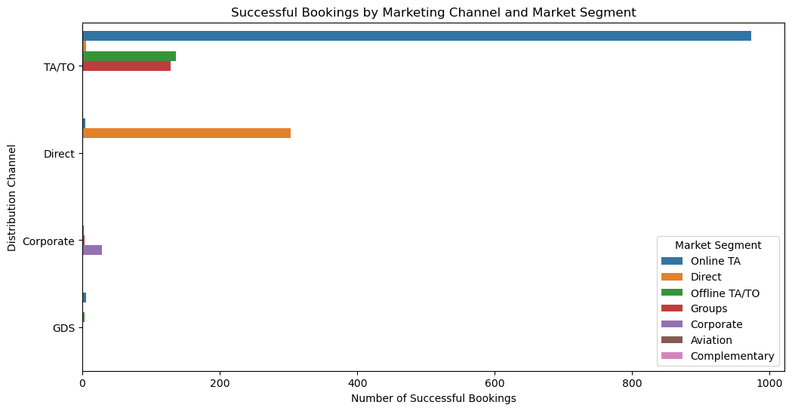
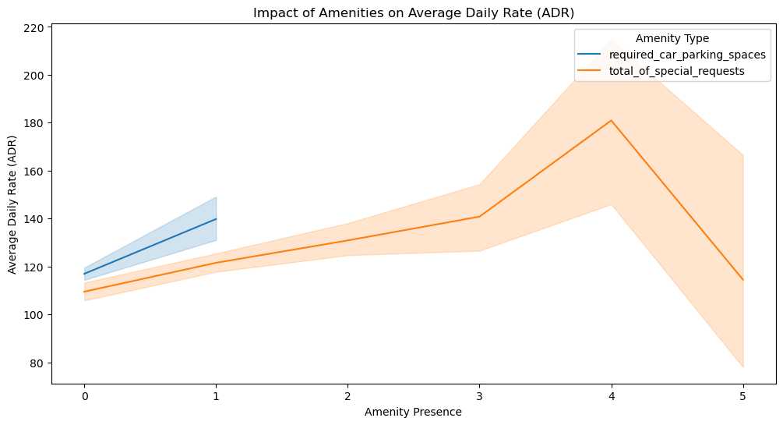
Task 2: 1. Which marketing channels and market segments contribute the most to successful bookings? 2. Which amenities or services have the highest impact on the average daily rate (ADR)? 3. What is the distribution of bookings across various distribution channels?
# Plotting successful bookings by marketing channel and segment
plt.figure(figsize=(12, 6))
sb.barplot(x='successful_bookings', y='distribution_channel', hue='market_segment', data=channel_segment_analysis)
plt.title('Successful Bookings by Marketing Channel and Market Segment')
plt.xlabel('Number of Successful Bookings')
plt.ylabel('Distribution Channel')
plt.legend(title='Market Segment')
plt.show()
amenities_columns = ['required_car_parking_spaces', 'total_of_special_requests']
plt.figure(figsize=(12, 6))
for amenity in amenities_columns:
sb.lineplot(x=amenity, y='adr', data=successful_bookings, label=amenity)
plt.title('Impact of Amenities on Average Daily Rate (ADR)')
plt.xlabel('Amenity Presence')
plt.ylabel('Average Daily Rate (ADR)')
plt.legend(title="Amenity Type")
plt.show()

Slide 12
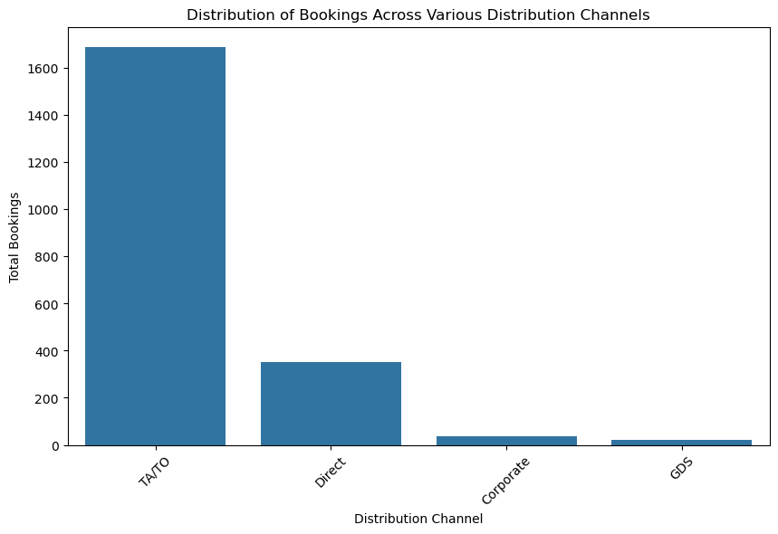
# Plotting the distribution of bookings across distribution channels
plt.figure(figsize=(10, 6))
sb.barplot(x='Distribution Channel', y='Total Bookings', data=booking_distribution)
plt.title('Distribution of Bookings Across Various Distribution Channels')
plt.xlabel('Distribution Channel')
plt.ylabel('Total Bookings')
plt.xticks(rotation=45)
plt.show()

Slide 13
Summary
Booking Trends:
Peak booking periods identified, with highest occupancy during specific months, weekends, and holidays.
Significant lead time observed, especially for longer stays.
Cancellation Analysis:
Cancellations are higher among specific market segments and booking channels.
Factors such as payment method, customer type, and lack of special requests correlate with higher cancellation rates.
Customer Demographics:
Repeat guests and families with children tend to contribute to longer stays and higher ADR.
Geographic analysis reveals top countries with high and low booking ratios.
Average Daily Rate (ADR) Insights:
ADR positively influenced by amenities such as parking and room upgrades.
Certain room types and booking channels consistently yield higher ADR.
Operational Recommendations:
Optimize room availability during peak times and reduce cancellations by targeting high-risk segments with incentives.
Align promotional offers based on seasonal trends and target loyal, high-ADR customer segments.

Slide 14
Conclusion
Maximizing Revenue through Optimized Booking Management:
Implement dynamic pricing during peak booking periods to capitalize on high demand.
Offer discounts and targeted campaigns during low-demand periods to boost occupancy.
Reducing Cancellations for Better Forecasting:
Focus on engaging customer segments prone to cancellations with incentives (e.g., loyalty programs, flexible payment options).
Collaborate closely with specific booking channels to manage high-cancellation segments more effectively.
Enhancing Customer Experience with Personalization:
Utilize insights on repeat guests to introduce personalized services and loyalty benefits.
Improve ADR by offering bundled packages, including amenities like parking, room upgrades, and special requests for higher-value guests.
Operational Efficiency and Strategic Planning:
Align staffing and operational resources with identified booking trends and peak seasons.
Encourage direct bookings through targeted marketing to reduce dependency on high-cost channels and improve profit margins.
Future Data-Driven Decisions:
Regularly monitor booking, cancellation, and ADR trends to adapt strategies proactively.
Consider further analysis on emerging patterns to continuously refine business strategies.

Slide 15
THANK YOU

